Slide 1
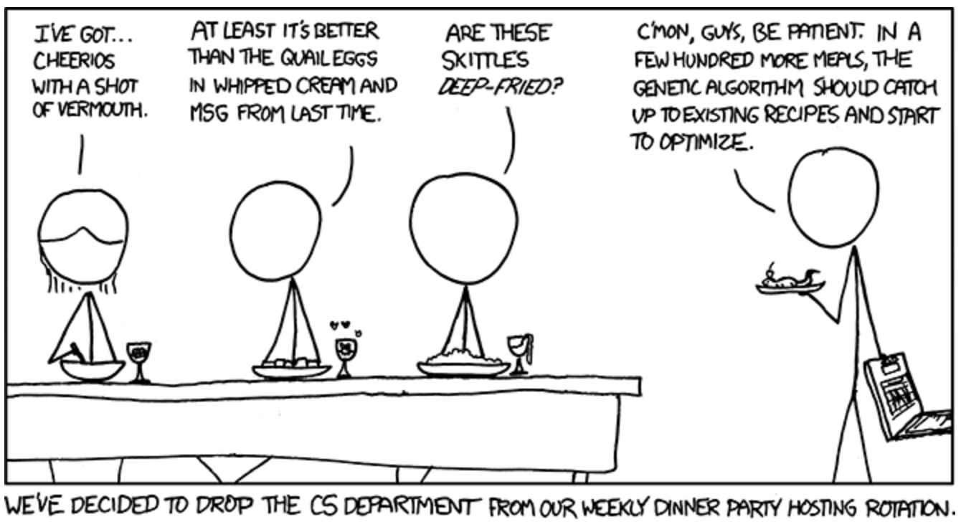
Exploration of Black Box Optimization Tools
https://xkcd.com/720/

Slide 2
Since our project is a little different than other groups, here is a proposed presentation outline:
Slide 1: Background - we can describe the chart we plan on creating and why it will be useful)
Slide 2: Technologies Considered - here we can list some of the optimizers from the review article and why we chose not to use them (wrong programming language, not enough documentation, etc.)
Slide 3: Bayes_Opt – here we can discuss one of the chosen optimizers. We can cover a few of Dave’s suggested points (such as summary of how it works, appeal of the choice, and drawbacks of choice).
Slide 4: Huat’s Optimizer – here we can discuss the other chosen optimizers. Again, we can cover a few of Dave’s suggested points (such as summary of how it works, appeal of the choice, and drawbacks of choice).
Slide 5 (maybe??) – Next Steps – here we can talk about how we plan on finding additional optimizers to explore and creating a variety of functions to test out with the optimizers ??

Slide 3
Background (we can describe the chart we plan on creating and why it will be useful)

Slide 4
Technologies Considered (here we can list some of the optimizers from the review article and why we chose not to use them (wrong programming language, not enough documentation, etc.)
Pymo optimizier (not enough documentation)
Coopr Opt Optimizier (currently does not support direct library interfaces to optimizers, which is a feature that is strongly supported by Python)

Slide 5
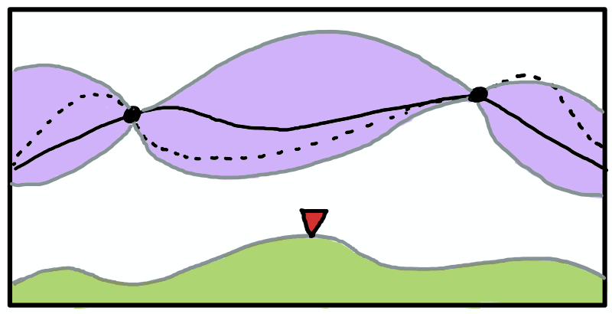
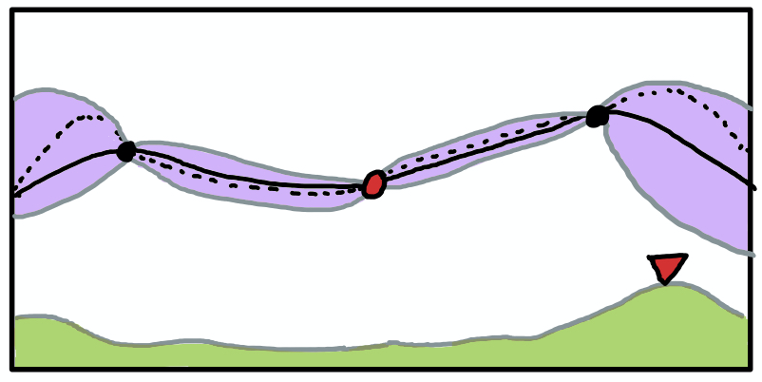
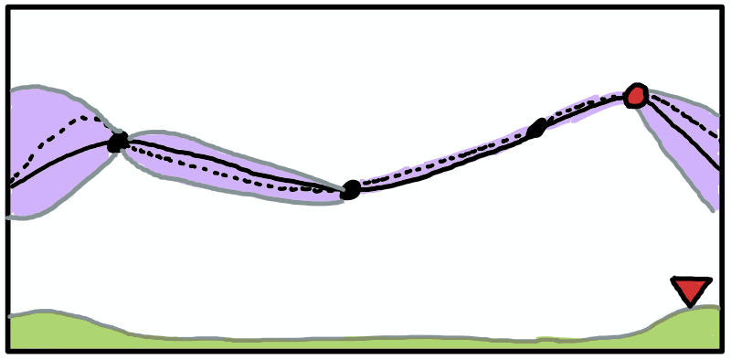


“Bayes_Opt” Bayesian Optimization
Posterior mean
True objective
Acquisition Max
This is a constrained global optimization package built upon Bayesian inference and Gaussian process.
Constrained global optimization - process of optimizing an objective function with respect to some variables in the presence of constraints on those variables
It attempts to find the maximum or minimum value of an unknown function in as few iterations as possible.
Its main drawback is that the Bayes_Opt will be very slow to converge when number of dimension is high
This is particularly useful for optimization of high-cost functions or situations where the balance between exploration and exploitation is important.
Example: Drilling for oil, testing each location may cost $1 million or more
Bayes_Opt:
1. for t = 1, 2… do
2. Find x_{t} by combining attributes of the posterior distribution in a utility (acquisition) function u and maximizing:
3. Sample the objective function:
y_{t} = f(x_{t}) = ɛ_{t}
4. Augment the data D_{1:t} = {D_{1:t-1}, (x_{t}, y_{t})}
5. end for
Posterior mean +/- std dev
Acquisition function

Slide 6
Optuna
Random Search
Samples random points and return the optimum value
Tree-structured Parzen Estimator
Creates a cost function to be minimized
Samples objective function and models the data using Parzen Estimators (KDE)
Draws new samples based on the greatest expected improvement
Covariance Matrix Adaptation Evolution Strategy (CMA-ES)
Sample new solutions
Rank solutions based on their score
Update guess (Covariance Matrix and Multivariate Gaussian Distribution)

Slide 7
Next Steps (here we can talk about how we plan on finding additional optimizers to explore and creating a variety of functions to test out with the optimizers ??)

Slide 8

Questions?

